Slide 1
DC schemes and DC AVCs: meeting the Regulator's challenge
Association of Member Nominated Trustees
22 November 2016

Slide 2
Limitations of reliance
Towers Watson Limited (Willis Towers Watson) (‘we/our/us’) has prepared these slides for the Association of Member Nominated Trustees (‘the Association’) in respect of the new DC Code of Practice 13.
In preparing these slides we have relied upon data supplied to us by third parties. While reasonable care has been taken to gauge the reliability of this data, these slides therefore carry no guarantee of accuracy or completeness and we cannot be held accountable for the misrepresentation of data by third parties involved.
These slides are provided for the Association solely for its use, for the purpose indicated. The slides are based on data/information available to us at the date of the slides and take no account of subsequent developments after that date. The slides may not be modified or provided by the Association to any other party without our prior written permission. The slides may also not be disclosed by the Association to any other party without our prior written permission except as may be required by law. In the absence of our express written agreement to the contrary, we accept no responsibility for any consequences arising from any third party relying on these slides or the opinions we have expressed. These slides are not intended by us to form a basis of any decision by a third party to do or omit to do anything.

Slide 3
Agenda
New DC Code of Practice
Chair’s statement
Differences to the original Code
AVCs
Next steps
Your views and experiences
Supplementary material

Slide 4
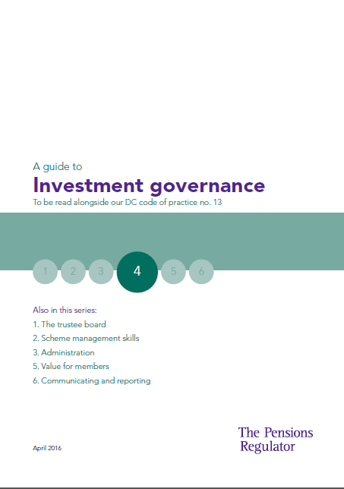
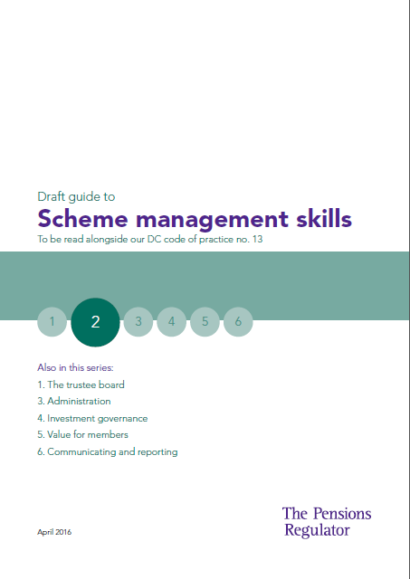
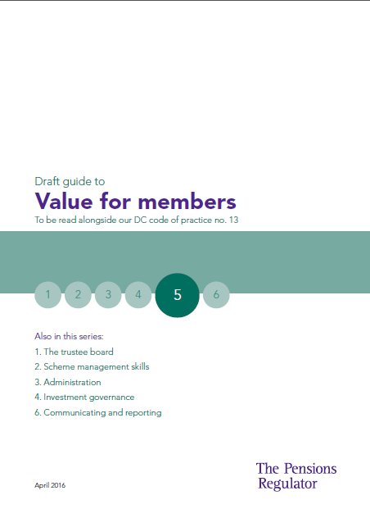
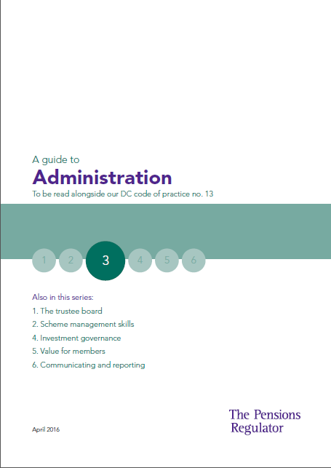
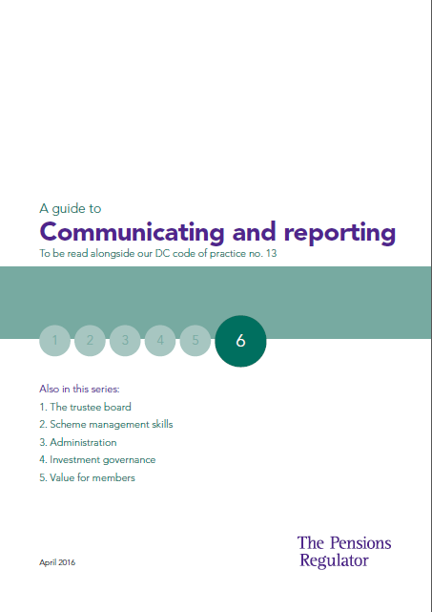
The revised DC Code of Practice
Came into force from July 2016
Based on Regulator’s ‘expectations’
Consisting of the Code and accompanying How To Guides
Underpins the production of the Chair’s Statement
Not prescriptive: methods trustees adopt will depend on nature of the scheme and membership. In some areas the Regulator states what it believes to be best practice

Slide 5
Revised DC Code
Both versions contain six sections
Section | Code of Practice 13
1 | Know your scheme
2 | Risk management
3 | Investment
4 | Governance
5 | Administration
6 | Communication
Section | Revised Code of Practice 13
1 | The trustee board
2 | Scheme management skills
3 | Investment governance
4 | Value for members
5 | Administration
6 | Communicating and reporting
Some areas and requirements are the same whilst others have been expanded or are new
Need to cross reference with the previous assessment

Slide 6
Six sections of the updated Code
The trustee board
Appointing a chair of trustees
Duties of the chair
Independence requirements for master trusts
Representation of members
Investment governance
Default arrangements
Setting investment objectives and a default strategy
Monitoring and reviewing the default strategy
Reviewing investment fund performance
Scheme management skills
TKU Requirements
Appointing advisers and managing relations
Overriding power in respect of appointing advisers
Conflicts of interest
Value for members
Charge controls
Costs and charges across all investment options
Value for member assessments
Code of Practice
Administration
Quality and robustness of administration function
Succession planning
Business disaster recovery
Core financial transactions processed promptly and accurately
Record-keeping
Communicating and reporting
Member communications
Chair’s statement
Statement of Investment Principles
The Pensions Regulator

Slide 7
Chair’s statement
The Regulator expects that being compliant with the requirements under the DC Code will provide assurance and evidence for drafting the Chair’s statement:
“we expect trustees to contemporaneously document and be able to evidence” content of chair’s statement
Setting objectives and strategies
Designing investment arrangements
Strategy and performance monitoring
Default arrangements and mapping
Investment governance
Trustee knowledge and understanding
Scheme management skills
Assessing value for members
Ongoing monitoring and evaluation
Strategy and performance monitoring
Value for members
Administration reporting
Core financial transactions
Accuracy – data record keeping
Administration
Annual chair’s statement
Communicating and reporting
Notes:
Each of the 6 sections contain expectations which relate directly to the drafting of the annual Chair’s statement
Legal requirements must be met
The level of compliance depends on the number of the Regulator’s additional expectations that are met
Some areas may require a scheme specific consideration when assessing the compliance

Slide 8
Differences to the original Code
DC Quality features have gone – however, still 48 requirements and 151 expectations to work through!
Less prescriptive – tPR acknowledges scheme specific approach is acceptable
Governance Statement – voluntary Governance Statement no longer required – focus on producing a ‘meaningful’ Chair’s Statement
Continuous improvement – theme of not standing still, adopt new technologies and regularly review processes and procedures
Question: How to undertake a comprehensive, yet streamlined assessment?

Slide 9
How does the new Code apply to AVC arrangements?
Defined benefit schemes where the scheme provides no DC benefits other than AVCs are not required to produce a Chair’s statement (or meet the associated quality standards) or to comply with the DWP charge cap.
However, beware of cases where AVCs hold not only voluntary contributions – "For the purposes of the guides, AVC arrangements are defined as arrangements which receive only voluntary contributions paid in addition to those due under the scheme rules, whether paid by the member or the employer (for example through salary sacrifice). Monies arising from a transfer in from another non-AVC arrangement in order to secure money purchase benefits do not fall into this category” (The Pensions Regulator).
“Though some specific legal obligations do not apply where the only money purchase benefits are provided are AVCs, other requirements do apply to AVCs. Trustee boards of schemes in this category should consider the risks to members in the context of the significance of the value of AVCs relative to the members’ overall benefits in the scheme, and where the law applies to AVCs, apply a proportionate approach to meeting the relevant standards in our DC Code”
The Pensions Regulator

Slide 10
Next steps
Assessment
Identifying levels of legislative compliance, TPR expectations and any scheme specific activities that go beyond these
Action Plan
Where gaps are identified in statutory provisions or trustees’ own objectives an action can be put in place to achieve these
Monitoring
Framework to be put in place to track objectives
Chair’s statement
Identifying actions for the Chair’s statement to help ensure this can be produced efficiently in future years and with sufficient level of supporting evidence (note: time critical as must be included with annual report and accounts)
Not an excuse for a tick box approach – an opportunity to improve member outcomes
Notes:
Timing for assessment?

Slide 11
Your views and experiences
Views?
Experiences?
Challenges?
Will the DC Code and guidance act as a catalyst for better member outcomes?
Will we see a change in DC structures/vehicles going forward?

Slide 12
Supplementary material

Slide 13
DC Code of Practice 13 – original version
Came into force from November 2013
Based on 31 DC quality features
Consisting of the Code and accompanying Regulatory Guidance
Built on underlying legislation (with the Code setting out standards and conduct to meet legislative requirements)
Inflexible – same requirements for any scheme with DC assets… TPR attitude – voluntary governance statement/‘comply or explain’

Slide 14
Now, the law requires…
“The law requires that…”
Statutory minimum requirements
There are 48 legal requirements underpinning the revised DC Code
4
14
The trustee board
Investment governance
10
7
Scheme management skills
Value for members
1
12
Administration
Communicating and reporting

Slide 15
Now, the Regulator expects…
“We expect trustee boards to…”
Expectations of a well-run scheme
The Regulator has set out 151 expectations that it believes will lead to a well governed scheme
10
35
The trustee board
Investment governance
22
22
Scheme management skills
Value for members
35
27
Administration
Communicating and reporting

Slide 16
The Guides – points of interest
Having the right people on the board
The trustee board
Role of the chair: strong effective leader, strategic, sets high standards for the board
Composition of the board: diverse, well balanced, consider societal demographics
Working effectively with the employer
Scheme management skills
Effectively manage commercial relationships (with advisers/providers)
Consider level of trustee knowledge and understanding and take steps to address gaps (a focus on training and development)
Substantive item at every meeting
Administration
Emphasis on administration being the bedrock of a well run scheme
Treat legislative timescales as absolute maxima
Data review at least annually; contribution and investments records reconciled at least monthly
© 2016 Willis Towers Watson. All rights reserved. Proprietary and Confidential. For Willis Towers Watson and Willis Towers Watson client use only.
10

Slide 17
The Guides – points of interest (cont)
Achieving good member outcomes
Investment governance
Engage with members about when and how they wish to take their DC benefits
Use this information as part of the considerations when determining investment options and strategies
VFM warrants a whole guide to itself
Value for members
What do members value? Where feedback is limited consider publicly available research to compare to similar schemes
Focus on scheme provision where the members bear the cost
Communicating and reporting
A focus on chair statements, SIPs and benefit statements
Take account of innovations in technology when deciding on format of communications
Understanding member views and communicating at the right time
© 2016 Willis Towers Watson. All rights reserved. Proprietary and Confidential. For Willis Towers Watson and Willis Towers Watson client use only.
11

Slide 18
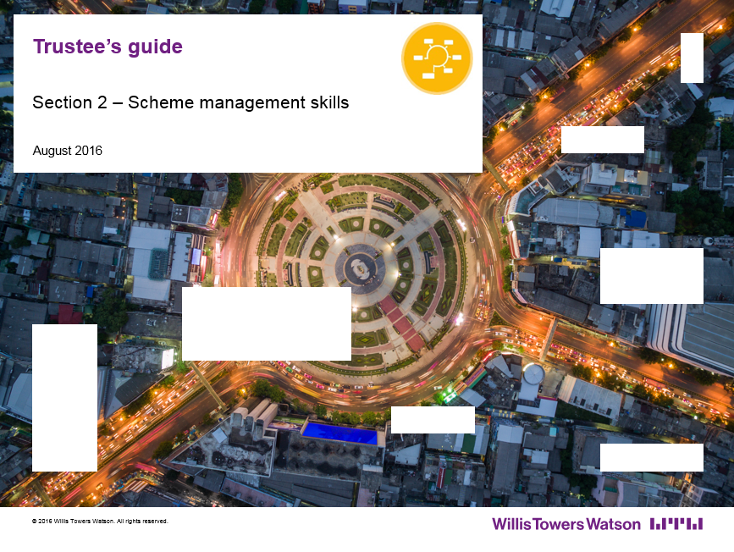
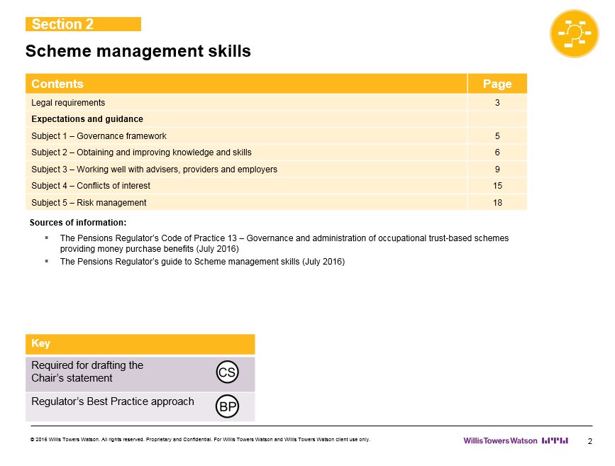
Willis Towers Watson GovernanceFit approach
Trustee Guide
A more logical and structured approach than the basic Code and How To Guides

Slide 19
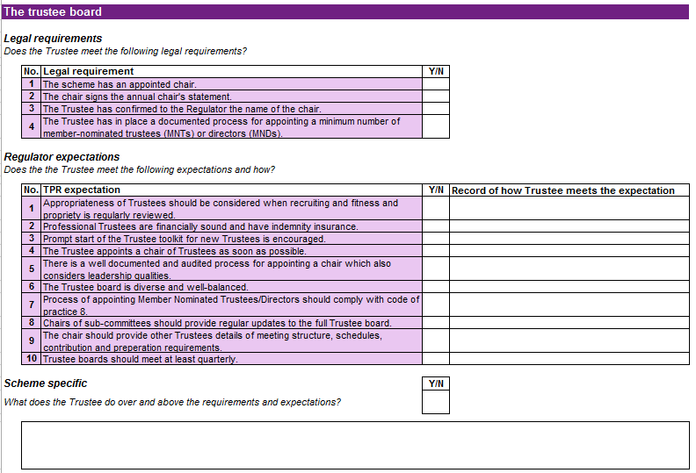
Willis Towers Watson GovernanceFit approach
Record of activities
Are all Legal requirements met for this area?
Each TPR expectation requires evidence of activity. The number of expectations met determines the proportion of this area of the wheel chart that is filled in.
Can record scheme specific activity within this box.
A comprehensive and fully documented record of compliance

Slide 20
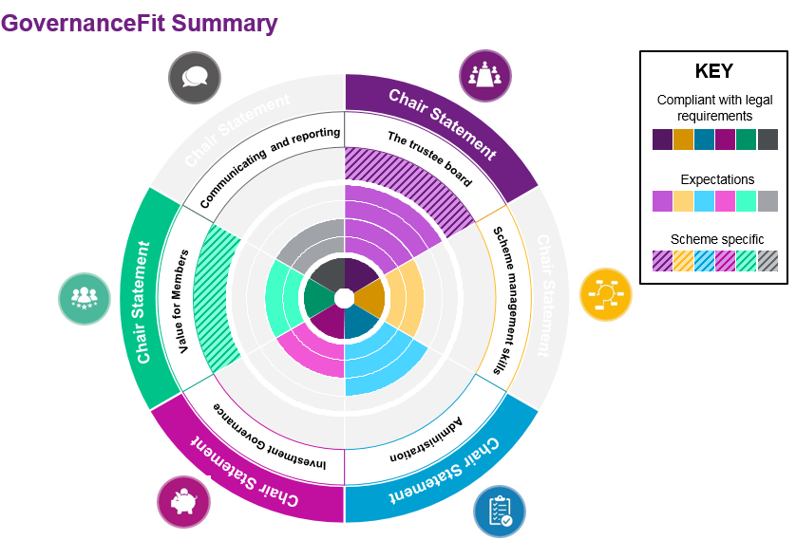
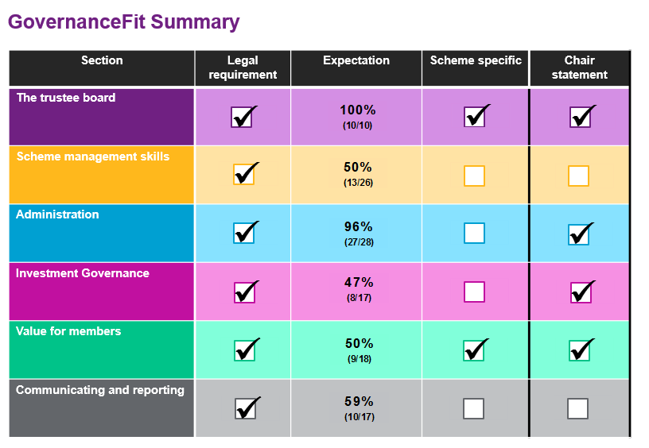
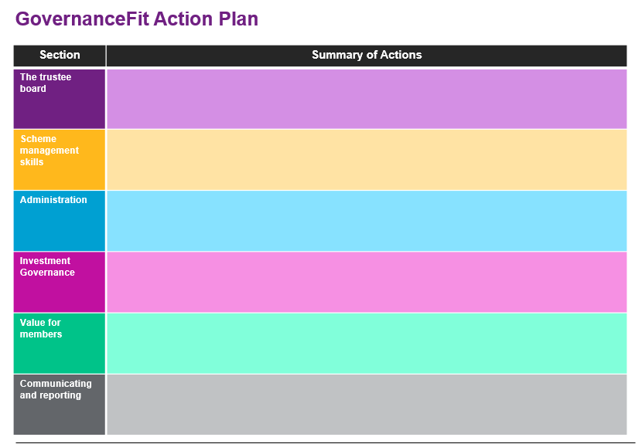
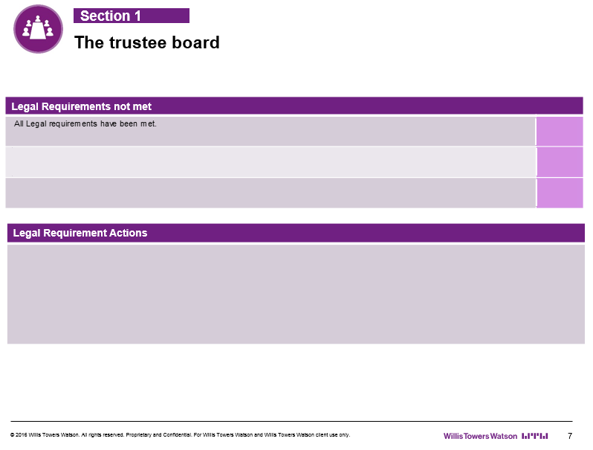
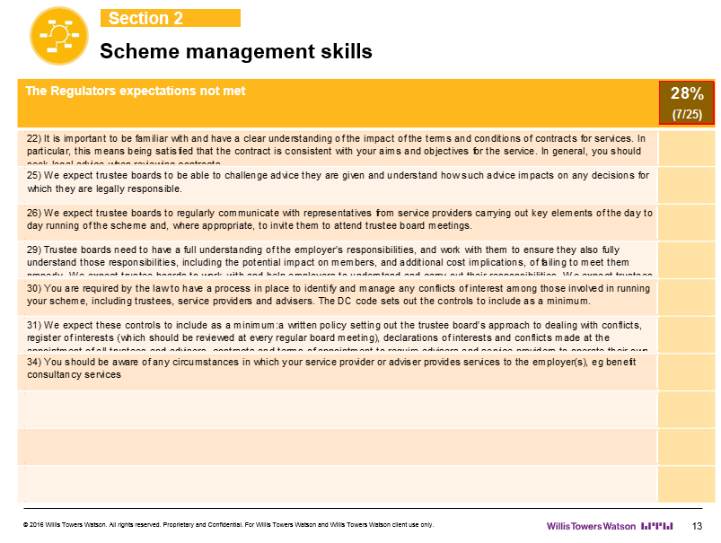
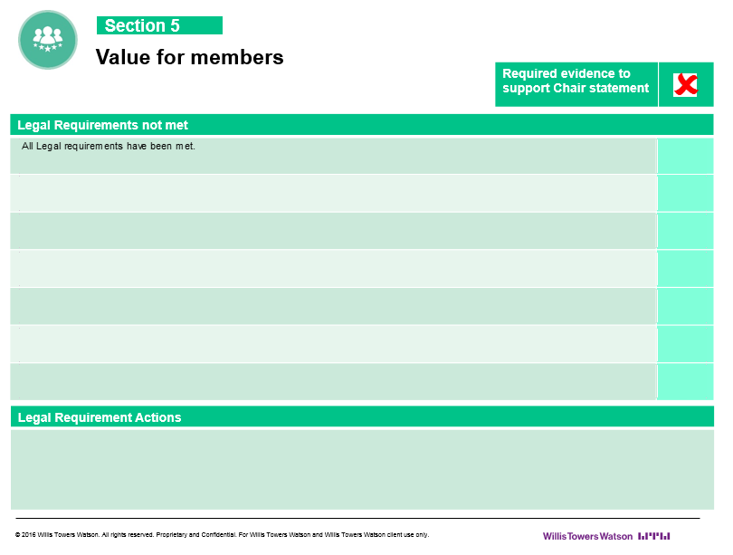
Willis Towers Watson GovernanceFit approach
Feedback report
Summary Table
Shows the assessment across all six areas in a tabular form
Shows number of regulator expectations achieved
View whether the current activity is fit for the Trustees Chairs statement
Summary Wheel
The wheel chart illustrates assessment across all areas
Easy to view areas of strength and weakness
Action Plan
Summarise the action plan for the scheme
Section slides
Summary slides of the six Sections split out in the report.
Shows the precise areas of Regulator expectations not met
A user-friendly summary, incorporating an action plan and ongoing monitoring framework

Slide 21
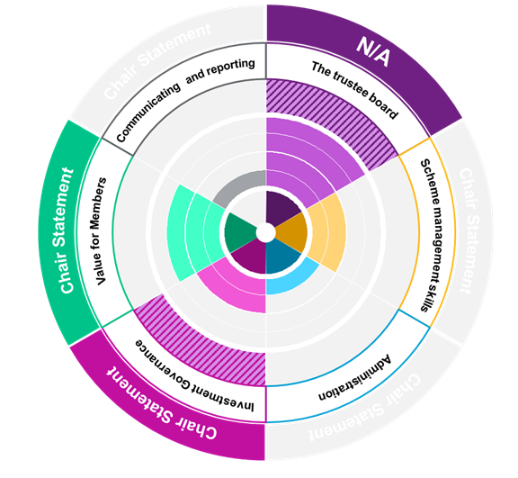
GovernanceFit summary - example
Scheme meets the Regulator’s expectations – shown as %
2
Sufficient evidence to deliver a compliant Chair’s statement
4
KEY
2
Compliant with legal requirements
4
1
Expectations
Scheme specific
Scheme adopts TPR best practice areas and/or undertakes further governance activities above and beyond the Regulator’s expectations
3
3
Scheme meets the essential legislative requirements – tick box exercise
1

Slide 22
What we’ve seen so far
Percentage of schemes meeting all legal requirements
96%
89%
The trustee board
Investment governance
89%
89%
Scheme management skills
Value for members
100%
89%
Administration
Communicating and reporting
GovernanceFit assessments carried out between 28 July 2016 and 16 November 2016

Slide 23
What we’ve seen so far
Percentage of Regulator expectations met by all schemes
80%
93%
The trustee board
Investment governance
90%
84%
Scheme management skills
Value for members
94%
90%
Administration
Communicating and reporting
GovernanceFit assessments carried out between 28 July 2016 and 16 November 2016

Slide 24
What we’ve seen so far
Percentage of Chair statement expectations met by all schemes
N/A
64%
The trustee board
Investment governance
54%
18%
Scheme management skills
Value for members
39%
71%
Administration
Communicating and reporting
GovernanceFit assessments carried out between 28 July 2016 and 16 November 2016

