Slide 1
Protecting Defined Benefit Pension Schemes
A White Paper published 19 March 2018

Slide 2
White Paper – key proposals
A stronger regulator
give TPR the power to issue punitive fines
introduction of a criminal offence for directors who deliberately put their pension schemes at risk Improve TPR’s information gathering powers
Improving scheme funding
Strengthen the Regulator’s ability to enforce Defined Benefit scheme funding standards, through a revised Funding Code
Require the trustees of Defined Benefit pension schemes to appoint a Chair and for that Chair to submit a triennial Chair’s Statement to TPR with their scheme valuation
Enabling consolidation

Slide 3
Consolidation
To encourage efficiencies and facilitate consolidation:
Consult on legislative framework and authorisation regime within which new forms of consolidation vehicles could operate;
Consult on a new accreditation regime which could help build confidence and encourage existing forms of consolidation;
Work with the Regulator to raise awareness of the benefits of consolidation; and
Consider some minor changes to guaranteed minimum pensions (GMP) conversion legislation to support benefit simplification and reduce complexities in existing benefit structures.
Notes:
The Industry shouldn’t underestimate the difficulties the government would have legislating to allow all schemes to simplify benefit structures under Section 67 and Section 68. Potentially interfering with A1P1 rights.
Any legislative change which allowed trustees to simplify members’ benefits, without consent would require a strong body of evidence to justify change. This would be controversial due to the potential winners and losers this creates over time.
We are continuing to work with the Industry to iron out some of their remaining issues with GMP conversion and equalisation.
This could be one way schemes could simplify a lot of the complexities in benefit structures.

Slide 4
Next steps
Stage one
– operational change, building on existing processes
Stage two
consultation (2018) – public and informal:
DWP – consultation on fines/penalties – June
DWP – informal engagement with stakeholders on Chair’s Statement planned for July/Aug
TPR clearer funding standards – informal engagement started, public consultation planned from 2019
DWP consolidation – informal engagement started, public consultation in the autum
legislative change (from 2019/20), subject to parliamentary time
Stage three – ongoing review
Notes:
We’re aware of proposals that are currently being considered to set up commercial style consolidator vehicles within the current regime.
I think its fair to say that when the current DB legislative framework was designed it was always intended that an employer would stand behind the scheme
We would want to ensure exchanging sponsor covenant and moving into a commercial consolidator improves the likelihood that members will receive full benefits.
Although no decisions have been made we would envisage that the Pensions Regulator would be best placed to authorise and supervise such vehicles, including ways to mitigate any risks or potential abuses.
There's lots of issues to be overcome and discussed and we would certainly need to consult on any specific proposals.

Slide 5
Consultation on clarifying and strengthening trustees’ investment duties
Launched Monday 18 June and open until 16 July 2018

Slide 6
Consultation on clarifying and strengthening trustees’ investment duties
The financial case…
Evidence of trustees incorrectly thinking that environmental, social and governance (ESG) risks are irrelevant to, or run counter to, financially material concerns
Examples of ESG risks:
Environmental: resource depletion, including water waste and pollution, and deforestation
Social: working conditions, including slavery and child labour; health and safety; employee relations and diversity, ageing populations; social unrest and income inequality.
Governance: executive pay; bribery and corruption; board diversity and structure

Slide 7
Consultation on clarifying and strengthening trustees’ investment duties
The popular case…
Increasing body of evidence that shows people want their money invested in a way that reflects their values and takes into account its broader impact upon the environment and citizens
82% of scheme members say they want their investments invested in a way that reflects their personal values (Natixis, 2016)
81% believe businesses have a wider social responsibility than simply making a profit (Ignition House, 2018)
Millennial investors are nearly twice as likely as non-millennials to invest in funds that target specific social or environmental outcomes (EY, 2017)
Responsible investing could be a key way to engage scheme members in their pension and encourage higher contributions.

Slide 8
Consultation on clarifying and strengthening trustees’ investment duties
The consultation…
Require trustees to set out in their Statement of Investment Principles:
how they take account of financially material considerations, including (but not limited to) those arising from environmental, social and governance (ESG) considerations, including climate change
their policies in relation to stewardship of investments, including engagement with investee firms and the exercise of voting rights
Also, in a separate statement, require trustees to set out:
how they take account of members’ views, e.g. on matters relating to the social impact of investments
Finally, trustees will also have to:
publish their SIP on a website;
produce and publish an implementation report setting out how they acted on the principles set out in the SIP, and how they acted on the statement which covered how they would take account of members’ views.

Slide 9
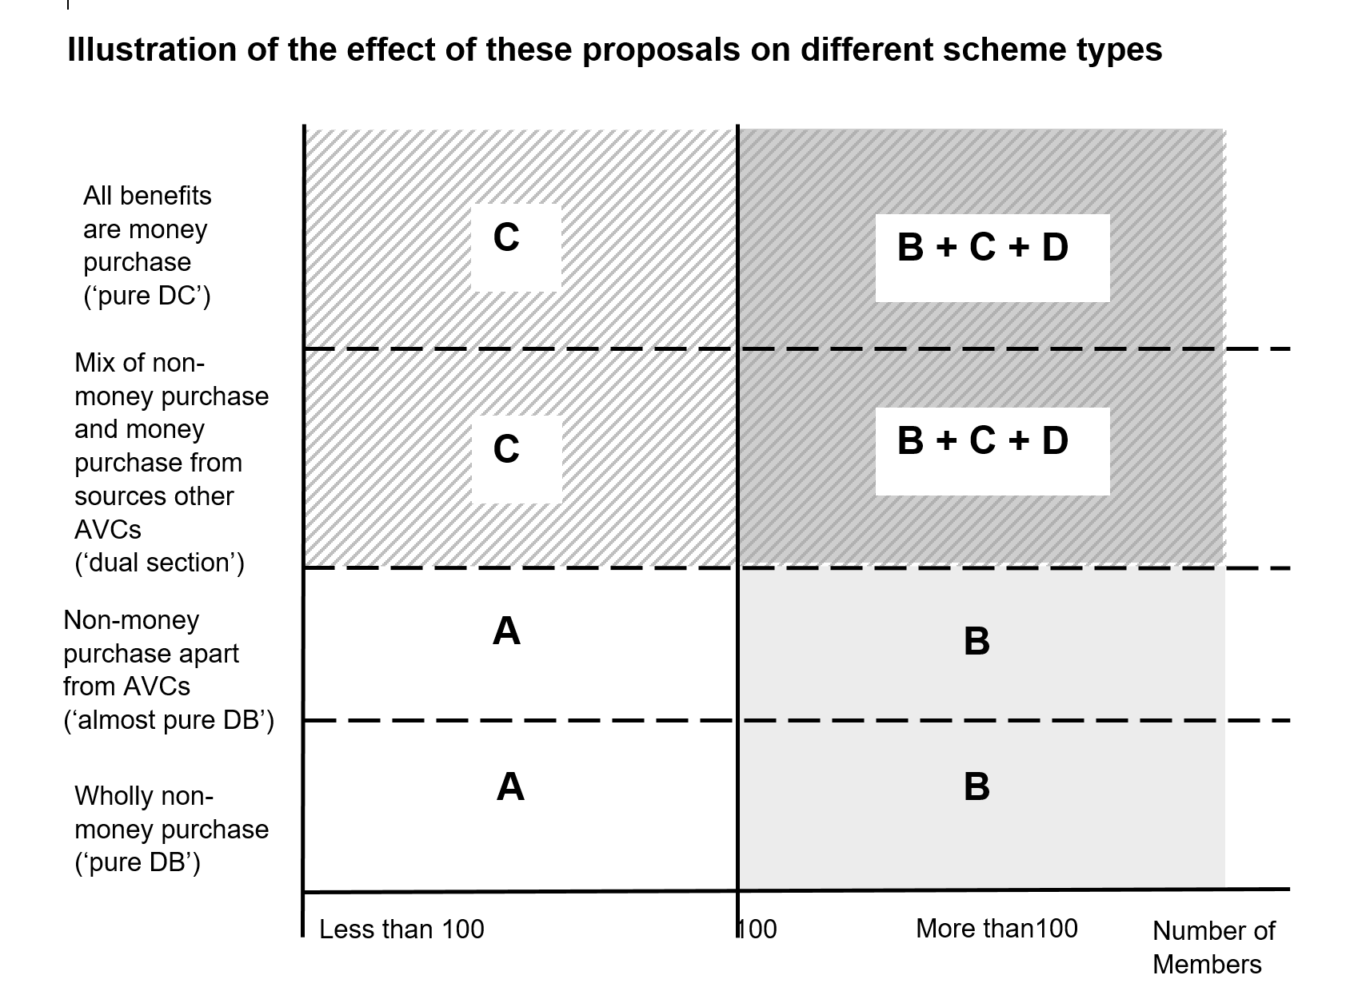
Illustration of the effect of these proposals on different scheme types
A
C
By Oct 2019 - Update default strategy to take account of financially-material considerations.
No new requirements
B
By Oct 2019 - Update SIP account for material considerations (including ESG and climate change) + stewardship. Next revision after Oct 2019 - Statement on how members’ views are taken into account.
By Oct 2019 – Publish SIP From Oct 2020 – Produce + publish implementation report. Next revision after 1 Oct 2019 - Publish statement on members’ views
D

Slide 10
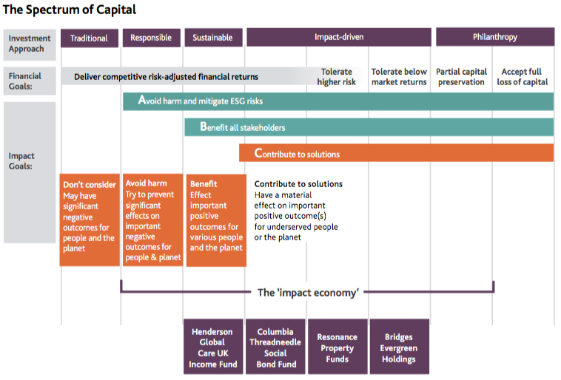
Social impact investment: Growing a Culture of Social Impact Investing in the UK

Slide 11
Social impact investment: Growing a Culture of Social Impact Investing in the UK
“Investment in the shares or loan capital of companies and enterprises that not only measure and report their wider impact on society — but also hold themselves accountable for delivering and increasing positive impact.”
In practice: Columbia Threadneedle Social Bond Fund (in partnership with Big Issue Invest)
Deploys capital to companies looking to fund socially beneficial activities.
The fund has £120 million assets under management and has met both its financial and social return objectives – providing an annualised return of 6.6% and investing in 83 bonds in thematic areas such as affordable housing and health and social care.
Big Issue Invest, as social partner, forms the majority of a social advisory committee that oversees and monitors the social efficacy of the fund.

Slide 12
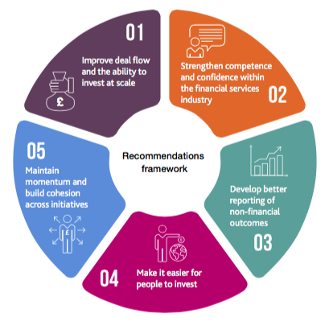
Social impact investment: Growing a Culture of Social Impact Investing in the UK
An industry-led taskforce, commissioned by the Prime Minister in March 2018, to progress the recommendations in the report, Growing a Culture of Social Impact Investing in the UK (November 2017).
Chaired by Elizabeth Corley (Vice Chair of Allianz Global Investors), the taskforce is working on generating a faster rate of innovation in the financial services industry to provide products that give savers and investors the opportunity to make a social impact.

Slide 13
Other DC Priorities
Automatic enrolment
Increased contributions
Self-employed
Engagement
Dashboard
Voluntary measures
Value for Money
Cost and charge transparency
Master trust authorisation / consolidation
Removal of barriers to less liquid investments
Collective DC (CDC)
Consulting
Legislating

