Slide 1
Helping people make proper provision for their retirement: Balance of power? Don't forget the scheme members!
Michelle Cracknell
AMNT – 22 November 2016
Notes:
Theme – Turning members from recipients of pensions to consumers
Why –
ageing society – new issues with living longer, new norms – working longer, long term care, no inheritance, housing wealth – not a given, split relationships personal responsibility for retirement income
changes to pensions landscape – DB to DC change, er-ee workplace relationship has changed physically and emotionally, multiple jobs, changes to rules – new does not replace old so legacy is a continuing indefinite issue (56 types of pension, X combination of charges on workplace pensions
Where we are now -
Pension freedom experience – sensible but not critical decisions, startling lack of knowledge from a self selected more knowledgeable group, transactional rather than holistic, struggle with process to implement
Behavioural – embarrassed to ask, F&F negative influence, reluctance or inability to get advice,
Burning platform – retirements from 2030 onwards look different with growing reliance in DC
What do we need to do
- intervention at age 50 – create a new social norm
Work together
No dead ends
Turning members from recipients of pensions to consumers of pensions

Slide 2
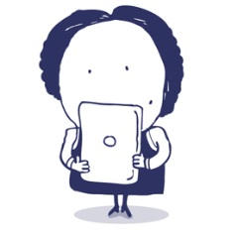
What we do?
I don’t understand my pension
We are here to help people with their pension question or issue
resolving problems an individual may have with their pension
delivering pre-booked telephone appointments for the Government service, Pension Wise
giving personal information and guidance on pension matters
sharing our knowledge and insight to contribute to Government and industry thinking on pensions
website and leaflets cover all aspects of pensions in the UK

Slide 3
Key facts
Channels
Phone
Webinars
Webchat
Website tools
Online enquiries
Outreach & shows
Seminars
Appointments
Written enquiries
Assisted support (Being launched)
Notes:
Channels
Talk about web chat popularu

Slide 4
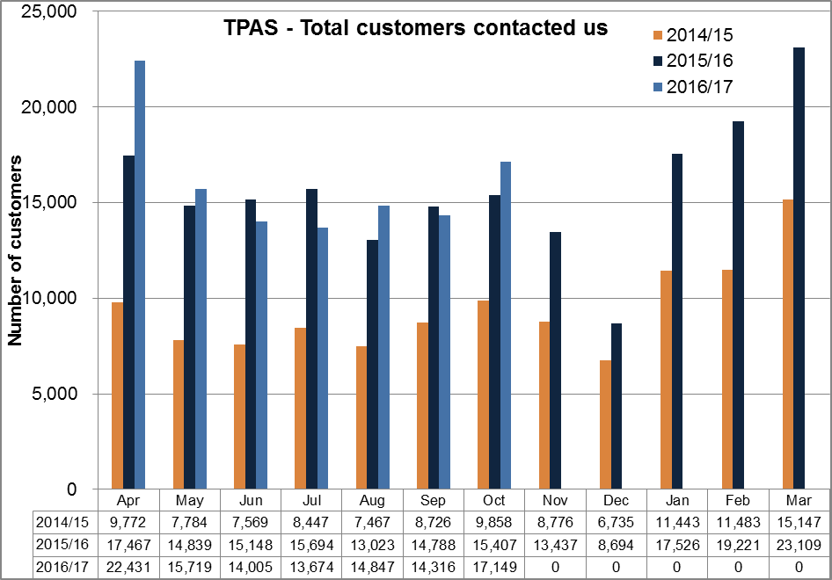
Key facts
On a year on year basis, we have been contacted by 112,141 customers compared with 106,366 2015/2016.
Notes:
T

Slide 5
Agenda
Balance of power? Don't forget the scheme members!
Balance of power? Shift in responsibility
Where we are now?
How can we help?

Slide 6
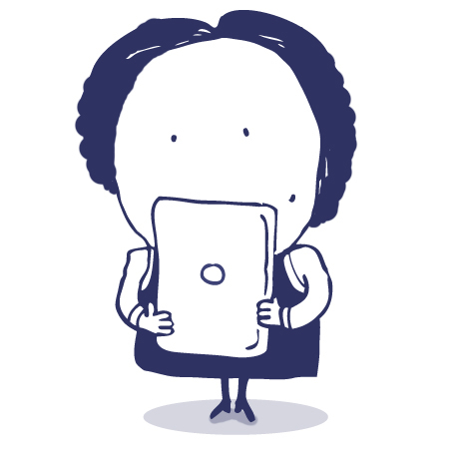
Section 1
Why do we need to change people from recipients of pension to consumers of pensions?

Slide 7
Shift in responsibility
Complex pensions………
DB to DC
Multiple jobs
Retirement options
Workplace changes
Future changes
…….complex lives
Living longer
Working longer
Lower probability of inheritance
Housing wealth – not a given
Split relationships
……..which is why customers can no longer be recipients but need help to become consumers of pensions

Slide 8
Section 2
Where are we today with awareness of pensions?

Slide 9
Knowledge
People don’t know what they don’t know
We cannot expect people to understand but we can help them make decisions
Notes:
People don’t know what they don’t know
Don’t know what they have – can be invisible when set up
Sold a product
Here related topics in press or from friends & family
We cannot expect people to understand but we can help them make decisions

Slide 10
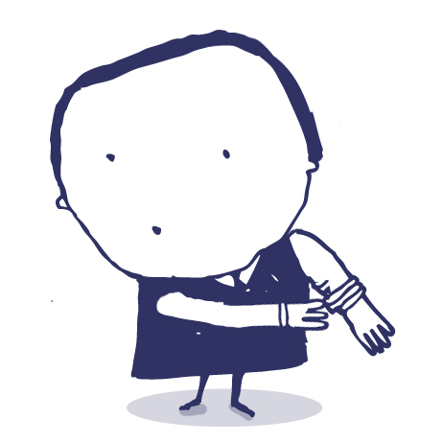
Process
Unclear, too slow, too difficult, too complicated
The long tail makes it impossible to make the process simple but we can do more behind the scenes

Slide 11
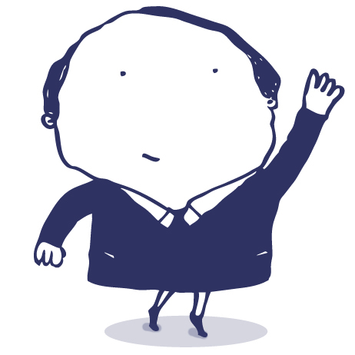
Trust
Few people call us because they have received a statement. They call us because something has happened in their life
We should be talking to people about their relevant issues

Slide 12
Section 3
What do we need to do to help members make better provision for their retirement?

Slide 13
What needs to be done
Making seeking guidance the norm
Looking at the customer journey for seeking pension guidance
Promoting health and wealth check at age 50

Slide 14
Working together
Promotion of guidance
all scheme and life events
at age 50
at retirement
Pension scams – use us to support your work
When things go wrong – e.g. overpayments / GMP reconciliations
Signposting / No dead ends

Slide 15
Working together
Hearing it from an independent party can help

Slide 16
Thank you

